Slide 1
Royalty / Rental Income
Pub 4012 Tab D
(Federal 1040-Line 17)
(NJ 1040-Line 22)
Notes:
1

Slide 2
Royalty/Rental Income Schedule E
Royalties can be reported on client’s K-1 or 1099-MISC – IN SCOPE
Rental income for land only – IN SCOPE
Rent can be reported on 1099-MISC
Rent reported on K-1 OUT OF SCOPE
Rental income on residential property – OUT OF SCOPE
Rental of main home for less than 15 days in year is considered in scope in that it does not need to be reported
Enter rents or royalties in Federal section \ Income \ Rents and Royalties (Schedule E). TaxSlayer transfers to 1040 Line 17
Notes:
Counselors who do a return with rental income on residential property that is Out of Scope can be held liable for any mistakes
2

Slide 3
Special Topics on TaxPrep4Free.org
See TaxPrep4Free.org Preparer page Special Topics documents
“Rent or Royalties on 1099-MISC”
“K-1 Income Entry”

Slide 4
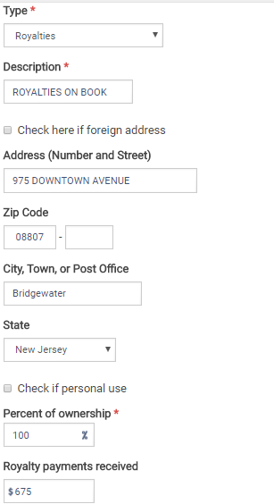
TS – Rents and Royalties Federal section \ Income \ Enter Myself \ Rents and Royalties (Schedule E)
Type of income (from drop-down menu)
Description
Royalty payments received

Slide 5
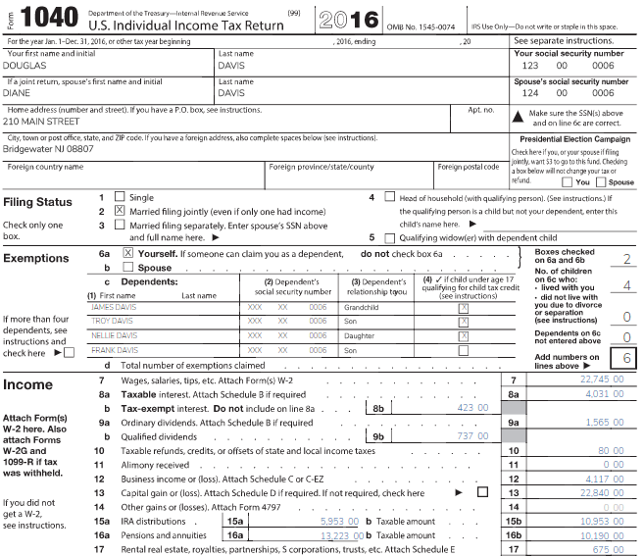
TS - Rent/Royalties on 1040
TaxSlayer transfers from Schedule E
Notes:
TaxSlayer transfers total from Schedule E to 1040 Line 17
5

